Slide 1
DATA WAREHOUSING
By
Syed Bakhtawar Shah Abid
Assistant Professor
Department of Computer Science
Data Warehousing

Slide 2
Reference Books
Data Warehousing Fundamentals
  by Paulraj Ponniah
The Data Warehouse Toolkit
by Ralph Kimball, Margy Ross
Building a Data Warehouse With Examples in SQL Server
by Vincent Rainardi
Data Warehousing

Slide 3
NEED FOR STRATEGIC INFORMATION
The executives and managers who are responsible for keeping the enterprise competitive need information to make proper decisions.
They need information to
  Formulate the business strategies,
  Establish goals,
  Set objectives, and
  Monitor results.
Data Warehousing

Slide 4
NEED FOR STRATEGIC INFORMATION
Here are some examples of business objectives:
  Retain the present customer base
  Increase the customer base by 15% over the next 5 years
  Gain market share by 10% in the next 3 years
  Improve product quality levels in the top five product groups
  Enhance customer service level in shipments
  Bring three new products to market in 2 years
  Increase sales by 15% in the North East Division
Data Warehousing

Slide 5
STRATEGIC INFORMATION
For making decisions about these objectives, executives and managers need information for the following purposes:
  To get in-depth knowledge of their company’s operations;
  Learn about the key business factors and how these affect one another;
  Monitor how the business factors change over time; and
  Compare their company’s performance relative to the competition and to industry benchmarks.
Data Warehousing

Slide 6
STRATEGIC INFORMATION
Executives and managers need to focus their attention on
  Customers’ needs and preferences,
  Emerging technologies,
  Sales and marketing results, and
  Quality levels of products and services.
The types of information needed to make decisions in the formulation and execution of business strategies and objectives are broad-based and encompass the entire organization.
Data Warehousing

Slide 7
STRATEGIC INFORMATION
Strategic information is not for running the day-to-day operations of the business.
It is not intended to
  Produce an invoice,
  Make a shipment,
  Settle a claim, or
  Post a withdrawal from a bank account.
Strategic information is far more important for the continued health and survival of the corporation.
Critical business decisions depend on the availability of proper strategic information in an enterprise.
Data Warehousing

Slide 8
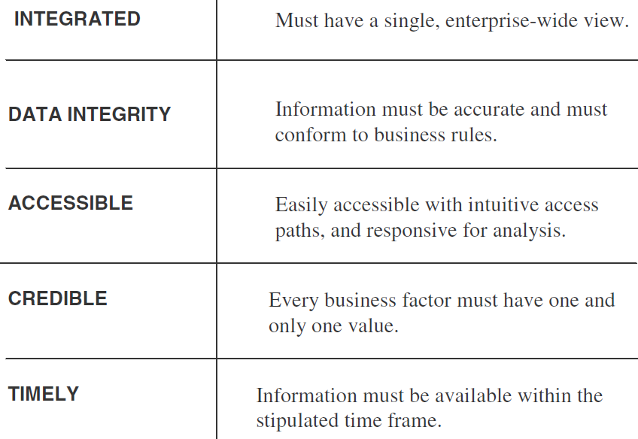
CHARACTERISTICS OF STRATEGIC INFORMATION
Data Warehousing

Slide 9
OPERATIONAL VERSUS DECISION-SUPPORT SYSTEMS
Making the Wheels of Business Turn
  Operational systems are online transaction processing (OLTP) systems.
  These are the systems that are used to run the day-to-day core business of the company.
  They are the so called bread-and-butter systems.
  Operational systems make the wheels of business turn.
  They support the basic business processes of the company.
  These systems typically get the data into the database.
  Each transaction processes information about a single entity such as a single order, a single invoice, or a single customer.
Data Warehousing

Slide 10
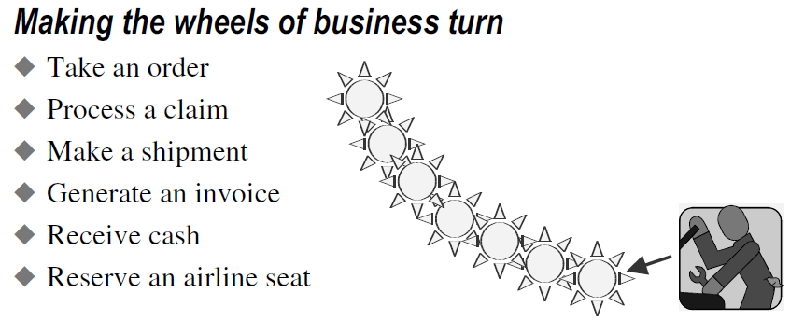
OPERATIONAL VERSUS DECISION-SUPPORT SYSTEMS
Data Warehousing

Slide 11
OPERATIONAL VERSUS DECISION-SUPPORT SYSTEMS
Watching the Wheels of Business Turn
  On the other hand, specially designed and built decision-support systems are not meant to run the core business processes.
  They are used to watch how the business runs, and then make strategic decisions to improve the business.
  Decision-support systems are developed to get strategic information out of the database, as opposed to OLTP systems that are designed to put the data into the database.
  Decision-support systems are developed to provide strategic information.
Data Warehousing

Slide 12
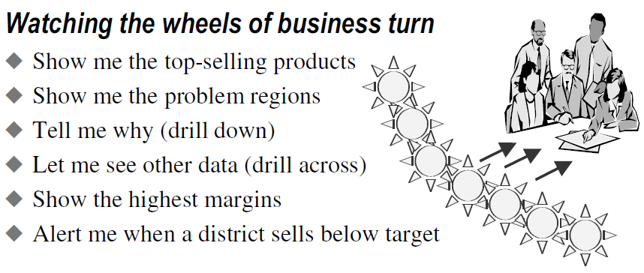
OPERATIONAL VERSUS DECISION-SUPPORT SYSTEMS
Data Warehousing

Slide 13
OPERATIONAL VERSUS DECISION-SUPPORT SYSTEMS
Different Scope, Different Purposes
  Therefore, we find that in order to provide strategic information we need to build informational systems that are different from the operational systems we have been building to run the basic business.
  It will be worthless to continue to dip into the operational systems for strategic information as we have been doing in the past.
  As companies face fiercer competition and businesses become more complex, continuing the past practices will only lead to disaster.
Data Warehousing

Slide 14
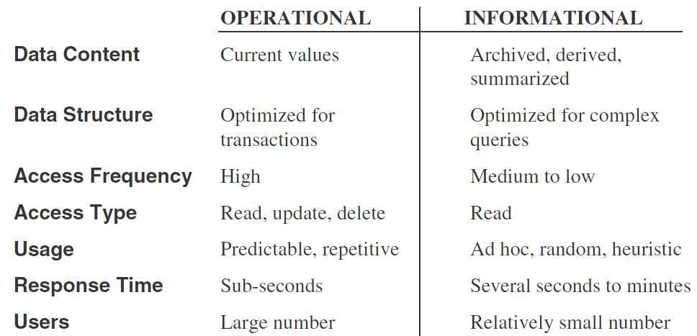
OPERATIONAL VERSUS DECISION-SUPPORT SYSTEMS
Data Warehousing

